Slide 1

The Groovy Puzzlers
As usual - Traps, Pitfalls, and End Cases
Notes:
CURRENT – JB NEXT - YOAV

Slide 2




Who we are
@_yoav_
https://github.com/yoav
Notes:
CURRENT – JB NEXT - YOAV

Slide 3


Who we are?
@jbaruch
github.com/jbaruch
linkd.in/jbaruch
stackoverflow.com/users/402053/jbaruch
Notes:
CURRENT – JB NEXT - YOAV

Slide 4

What Frog?

Slide 5

What Frog?

Slide 6

What Frog?

Slide 7

What Frog?
Notes:
Senior Front-End Developer
Senior Java Developer
DevOps Engineer
QA Engineer
2nd Level Support Engineer
Pre-sale Engineer

Slide 8
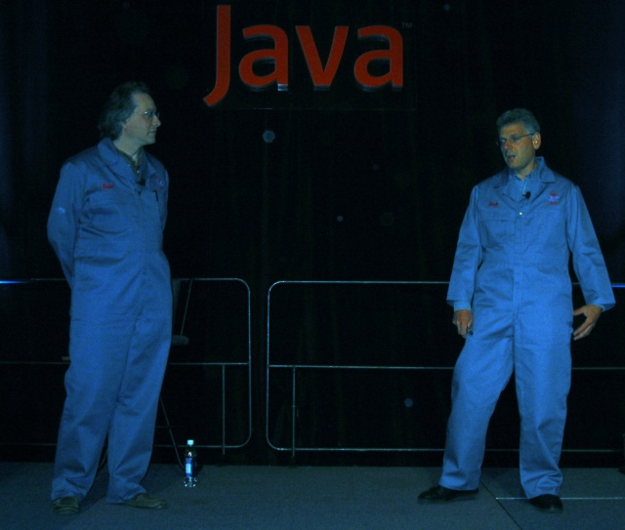
Click and hack
the typing brothers
Notes:
CURRENT – JB NEXT - YOAV
2001 OracleWorld: Joshua Bloch, Neal Gafter

Slide 9
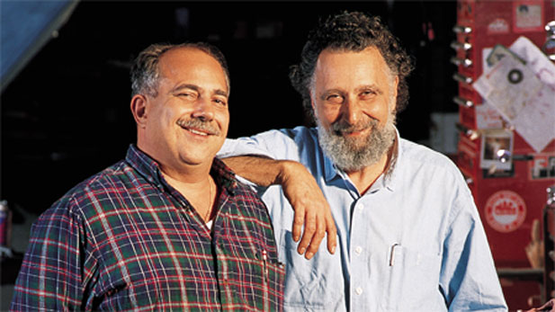
BTW…
Notes:
CURRENT – JB NEXT - YOAV
The Car Show (1977-2012) Click and Clack, the Tappet Brothers - Tom and Ray Magliozzi

Slide 10


Two entertaining guys on stage
Funny Puzzling questions
You think and vote
Lots of T-shirts flying in the air
Official twitter handle! groovypuzzlers
Notes:
CURRENT – YOAV
NEXT - JB

Slide 11

First rule of the puzzlers:
No cheating!
Notes:
CURRENT – YOAV
NEXT - JB

Slide 12
First rule of the puzzlers:
Cédric?!
No cheating!
Notes:
CURRENT – YOAV
NEXT - JB

Slide 13

Consider the puzzlers correct as of 2.4.1
Notes:
CURRENT – YOAV
NEXT - JB

Slide 14

Notes:
CURRENT – YOAV
NEXT - JB

Slide 15

Notes:
CURRENT – JB
NEXT - YOAV

Slide 16

class Conference {def name; def year} def gr = new Conference(name: 'Greach', year: 2014) gr.each {println it}
class=class Conference name=Greach year=2014
Conference@XXXXXX
Startup failure
Greach 2014
Notes:
CURRENT – JB
NEXT - YOAV

Slide 17

Not exactly iteration, is it?
Notes:
CURRENT – JB
NEXT - YOAV

Slide 18
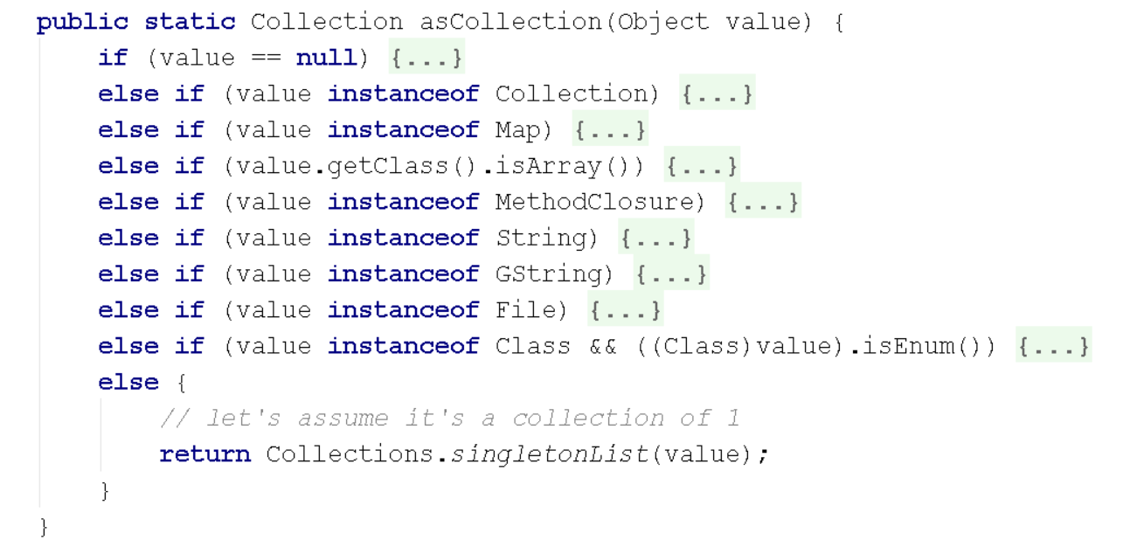
RTFS (Read the F***ing source)!
Notes:
CURRENT – JB
NEXT - YOAV

Slide 19

Absolutely Groovy
Notes:
CURRENT – YOAV
NEXT - JB

Slide 20
-3.abs()
3
NoSuchMethodError
-3
Execution Failure
Notes:
CURRENT – YOAV
NEXT - JB

Slide 21
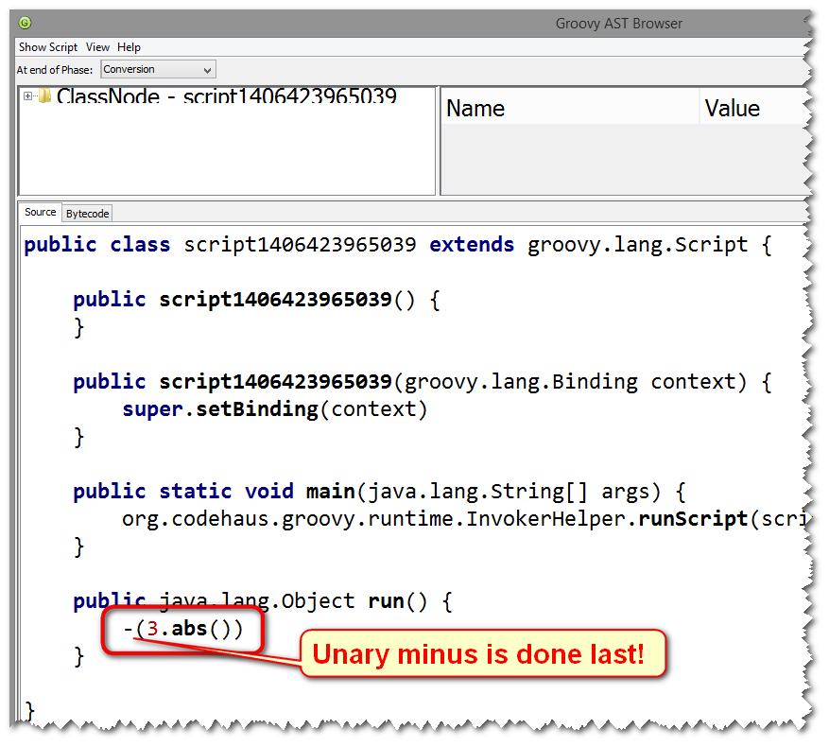

Notes:
CURRENT – YOAV
NEXT - JB

Slide 22
Fix is simple
(-3).abs()
or
int value = -3 value.abs()
Notes:
CURRENT – YOAV
NEXT - JB

Slide 23
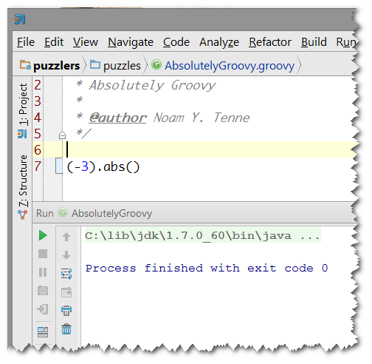
My idea prints nothing when I copy paste this code. What gives?
Notes:
CURRENT – YOAV
NEXT - JB

Slide 24
Println for the rescue!
println (-3).abs()
-3
3
3 and NullPointerException
-3 and NullPointerException
Notes:
CURRENT – YOAV
NEXT - JB

Slide 25

Notes:
CURRENT – YOAV
NEXT - JB

Slide 26
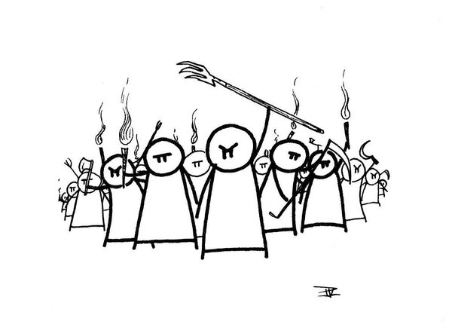
Delete all parentheses!
Compiler will figure it out!
Notes:
CURRENT – YOAV
NEXT - JB

Slide 27
println (-3).abs()
-3
Caught: java.lang.NullPointerException: Cannot invoke method abs() on null object
java.lang.NullPointerException: Cannot invoke method abs() on null object
at AbsolutelyGroovy.run(AbsolutelyGroovy.groovy:7)
at com.intellij.rt.execution.application.AppMain.main(AppMain.java:134)
Notes:
CURRENT – YOAV
NEXT - JB

Slide 28

“All problems in computer science can be solved by another pair of parentheses”
John McCarthy, the inventor of LISP
Notes:
CURRENT – YOAV
NEXT - JB

Slide 29
Just Throw in some more parentheses!
println ((-3).abs())
or
int value = -3 println value.abs()
Notes:
CURRENT – YOAV
NEXT - JB

Slide 30

And the t-shirt goes to…
Notes:
CURRENT – YOAV
NEXT - JB

Slide 31

Why so primitive?
Notes:
CURRENT – JB
NEXT - YOAV

Slide 32

Why so primitive?
def x = int println x if ((x = long)) { println x } if (x = boolean ) { println x }
Notes:
CURRENT – JB
NEXT - YOAV

Slide 33
Why so primitive?
def x = int println x if ((x = long)) { println x } if (x = boolean ) { println x }
Startup Error
int, long, boolean
java.lang.Integer, java.lang.Long, java.lang.Boolean
int
Notes:
CURRENT – JB
NEXT - YOAV

Slide 34
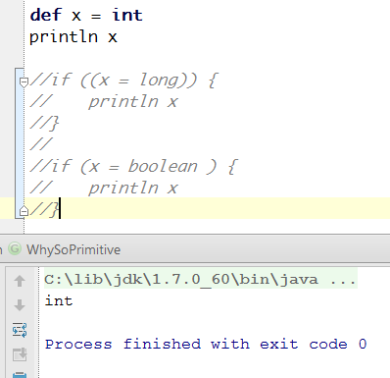
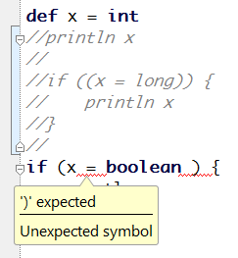
That was easy. But why?
That’s OK
That’s not OK
Notes:
CURRENT – JB
NEXT - YOAV

Slide 35
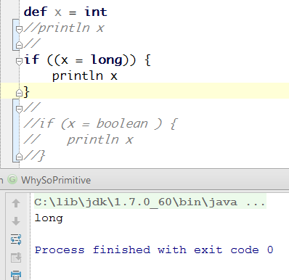

How about that:
Notes:
CURRENT – JB
NEXT - YOAV

Slide 36
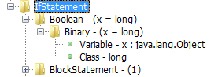
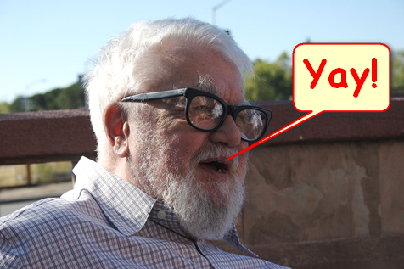
(Groovy) truth can hurt so just parentheses for a rescue (or not)
Notes:
CURRENT – JB
NEXT - YOAV

Slide 37

Whodunit
Notes:
CURRENT – YOAV
NEXT - JB

Slide 38
Whodunit
Closure whodunit() { { 'The butler did it.' } }
println whodunit()
NullPointerException
whodunit_closure1@xxxxxxx
Startup error
The butler did it.
Notes:
CURRENT – YOAV
NEXT - JB

Slide 39

That is very sad.
Notes:
CURRENT – YOAV
NEXT - JB

Slide 40

Not sure if
Closure or code block
Notes:
CURRENT – YOAV
NEXT - JB

Slide 41

Cheer up, the fix is easy!
Closure whodunit() { { -> 'The butler did it.' } }
Notes:
CURRENT – YOAV
NEXT - JB

Slide 42

And the t-shirt goes to…
Notes:
CURRENT – YOAV
NEXT - JB

Slide 43

Public - Property!
Notes:
CURRENT – JB
NEXT – YOAV

Slide 44
Get your piece of public property.
trait Public { public String property = "I am all public!" } class Property implements Public {} Property publicProperty = new Property()
Notes:
CURRENT – JB
NEXT – YOAV

Slide 45
trait Public { public String property = "I am all public!" } class Property implements Public {} Property publicProperty = new Property()
publicProperty.@property
publicProperty.Public__property
publicProperty.getProperty()
publicProperty.property
Notes:
CURRENT – JB
NEXT – YOAV

Slide 46

Notes:
CURRENT – JB
NEXT – YOAV

Slide 47
Two questions:
What’s up with the strange name?!
How the hell I am supposed to know?!
Notes:
CURRENT – JB
NEXT – YOAV

Slide 48

Answer to 1:
In Soviet Russia
You don’t access public property
Notes:
CURRENT – JB
NEXT – YOAV

Slide 49

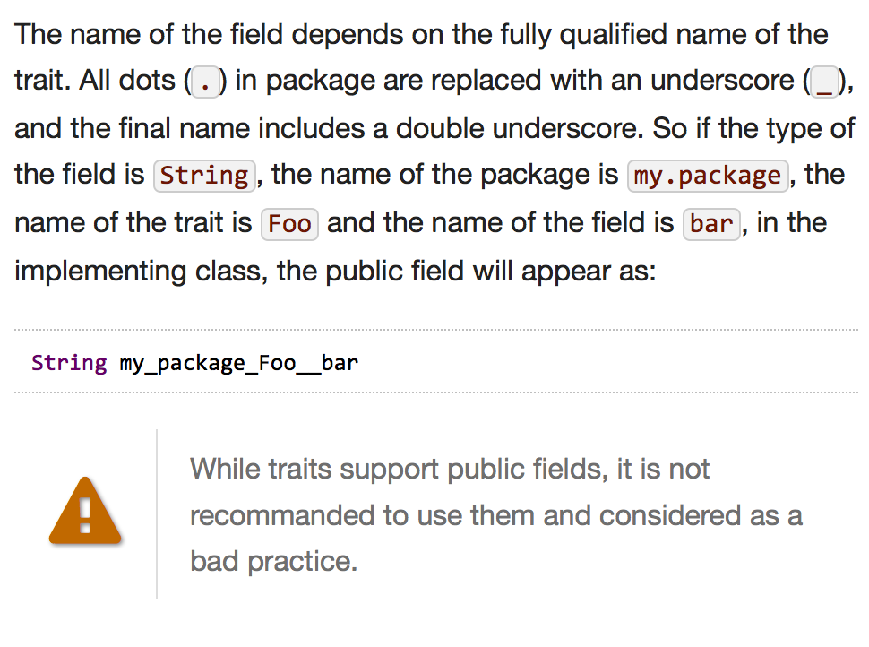
Answer to 2:
READ THE TRAITS DOCS
http://beta.groovy-lang.org/docs/groovy-2.3.0/html/documentation/core-traits.html
IT’S ALL THERE
Notes:
CURRENT – JB
NEXT – YOAV

Slide 50

Out of range
Notes:
CURRENT – YOAV
NEXT - YOAV

Slide 51
Out of range
def range = 1.0..10.0 assert range.contains(5.0) println range.contains(5.6)
Assertion Failed
false
true
NullPointerException
Notes:
CURRENT – YOAV
NEXT - YOAV

Slide 52

Notes:
CURRENT – YOAV
NEXT - YOAV

Slide 53
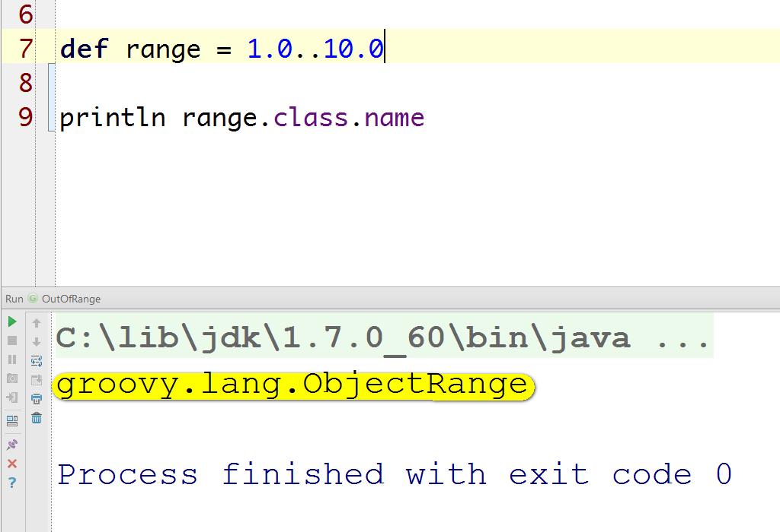
Road to Enlightenment, step 1:
Notes:
CURRENT – YOAV
NEXT - YOAV

Slide 54
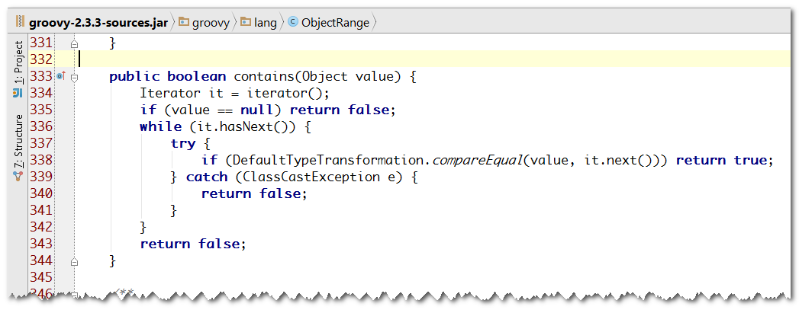
Road to Enlightenment, step 2:
Notes:
CURRENT – YOAV
NEXT - YOAV

Slide 55
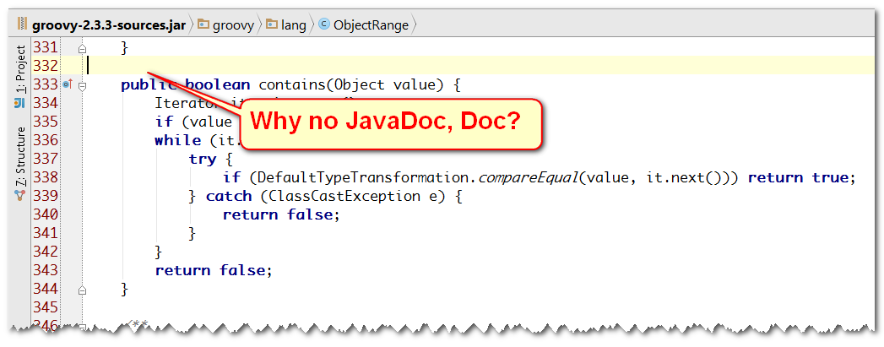
Road to Enlightenment, step 2:
Notes:
CURRENT – YOAV
NEXT - YOAV

Slide 56
Road to Enlightenment, step 3:
Iterator iterator = (1.0..10.0).iterator() while (iterator.hasNext()) { print "${iterator.next()} " }
1.0 2.0 3.0 4.0 5.0 6.0 7.0 8.0 9.0 10.0
Notes:
CURRENT – YOAV
NEXT - YOAV

Slide 57
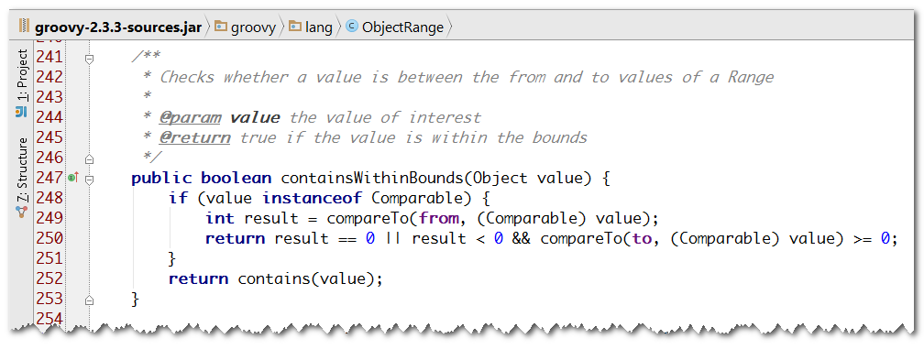
Fix is simple, but questionable
Notes:
CURRENT – YOAV
NEXT - YOAV

Slide 58

So, groovy, you say that 1.0..10.0 does not contain 5.6?
Notes:
CURRENT – YOAV
NEXT - YOAV

Slide 59
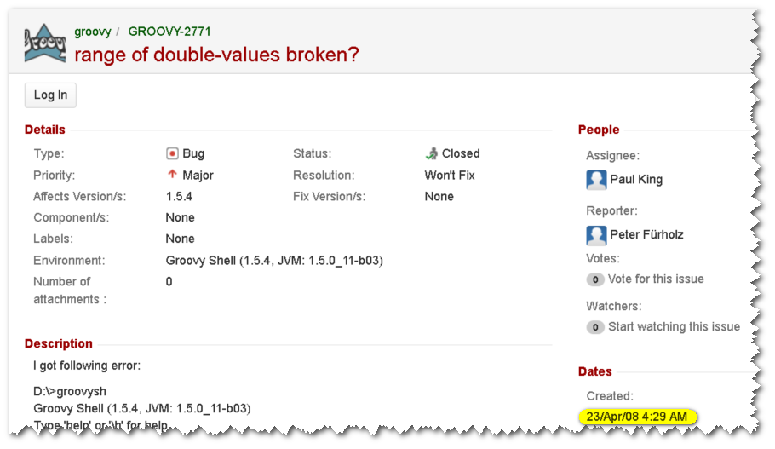
What can be done?
We don’t care about the actual implementation class of 1.0..10.0
Make it “RealRange” or “ContinuousRange” or whatever
In this implementation delegate contains to containsWithinBounds.
Fix GROOVY-2771
Thank you.
Notes:
CURRENT – YOAV
NEXT - YOAV

Slide 60

And the t-shirt goes to…
Notes:
CURRENT – YOAV
NEXT - YOAV

Slide 61

Power range(rs)
Notes:
CURRENT – YOAV
NEXT - JB

Slide 62
Let’s take one down…
[0..9].each { println(it - 1) }
-1 0 1 2 3 4 5 6 7 8
0 1 2 3 4 5 6 7 8 9
[0, 2, 3, 4, 5, 6, 7, 8, 9]
[-1, 0, 1, 2, 3, 4, 5, 6, 7, 8]
Notes:
CURRENT – YOAV
NEXT - JB

Slide 63

Notes:
CURRENT – YOAV
NEXT - JB

Slide 64
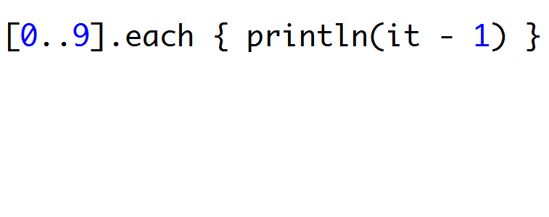
I just tricked you. Ha!
Notes:
CURRENT – YOAV
NEXT - JB

Slide 65
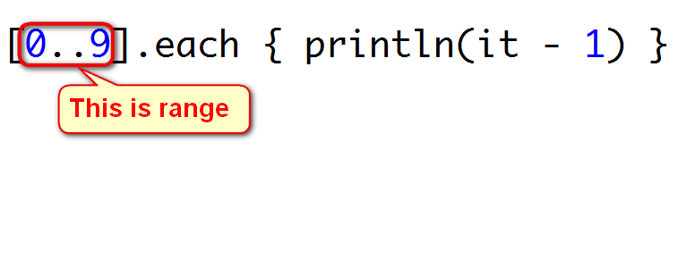
I just tricked you. Ha!
Notes:
CURRENT – YOAV
NEXT - JB

Slide 66
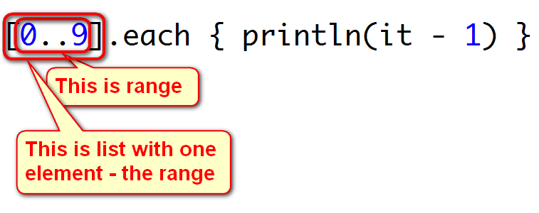
I just tricked you. Ha!
Notes:
CURRENT – YOAV
NEXT - JB

Slide 67
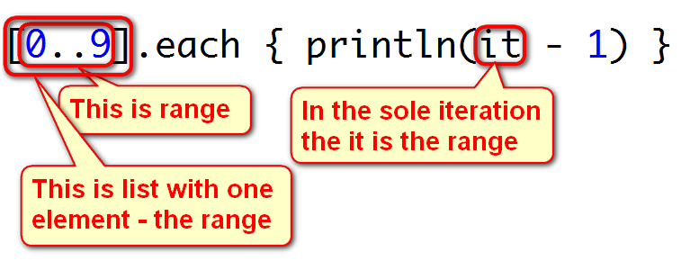
I just tricked you. Ha!
Notes:
CURRENT – YOAV
NEXT - JB

Slide 68
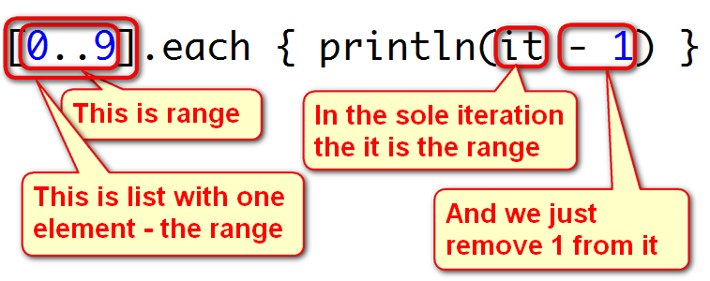
I just tricked you. Ha!
Notes:
CURRENT – YOAV
NEXT - JB

Slide 69

Notes:
CURRENT – YOAV
NEXT - JB

Slide 70
And the t-shirt goes to…
Notes:
CURRENT – YOAV
NEXT - JB

Slide 71

Fresh in memory!
Notes:
CURRENT – JB
NEXT - JB

Slide 72

Treaye map, Arrr!
Notes:
CURRENT – JB
NEXT - JB

Slide 73
Treaye map, Arrr!
def key = 'x' def map = [key: 'treasure'] def value = map.get(key) println value
Notes:
CURRENT – JB
NEXT - JB

Slide 74
def key = 'x' def map = [key: 'treasure'] def value = map.get(key) println value
NoSuchElementException
null
treasure
Lily-livered swab, BSOD!
Notes:
CURRENT – JB
NEXT - JB

Slide 75

Notes:
CURRENT – JB
NEXT - JB

Slide 76
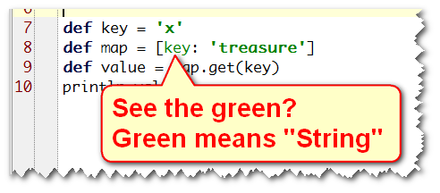
By default, key is a literal, no matter what
Notes:
CURRENT – JB
NEXT - JB

Slide 77
Fixes, lots of them
def map = [(key): 'treasure']
map.put(key, 'treasure')
map."$key" = 'treasure'
map[key] = 'treasure'
Notes:
CURRENT – JB
NEXT - JB

Slide 78

More routes t' to treaaye!
Notes:
CURRENT – JB
NEXT - YOAV

Slide 79
A number of routes
def map = [2: 'treasure'] def key = 2 def value = map."$key" println value
Notes:
CURRENT – JB
NEXT - YOAV

Slide 80
def map = [2: 'treasure'] def key = 2 def value = map."$key" println value
NoSuchElementException
null
treasure
Kernel Panic, ye lice-infested bucko!
Notes:
CURRENT – JB
NEXT - YOAV

Slide 81

Now what?!
Notes:
CURRENT – JB
NEXT - YOAV

Slide 82

By default, key is a literal, no matter what, except numbers.
def map = [2: 'treasure'] println map.keySet().first().class.name
java.lang.Integer
Notes:
CURRENT – JB
NEXT - YOAV

Slide 83

And the t-shirt goes to…
Notes:
CURRENT – JB
NEXT - YOAV

Slide 84

Save the date
Javaone is coming
Notes:
CURRENT – YOAV
NEXT - YOAV

Slide 85
Java2, anyone?
List<Long> list = [1,2,3] def now = new Date() list << now println list
Notes:
CURRENT – YOAV
NEXT - YOAV

Slide 86
List<Long> list = [1,2,3] def now = new Date() list << now println list
Startup Failure
[1, 2, 3, WED Sep 10 17:35:11 CDT 2014]
[1, 2, 3, 1410388511456]
ClassCastException
Notes:
CURRENT – YOAV
NEXT - YOAV

Slide 87
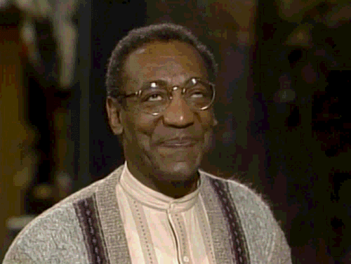
Oh, wait, I know what happened!
Notes:
CURRENT – YOAV
NEXT - YOAV

Slide 88

Erasure!
Notes:
CURRENT – YOAV
NEXT - YOAV

Slide 89
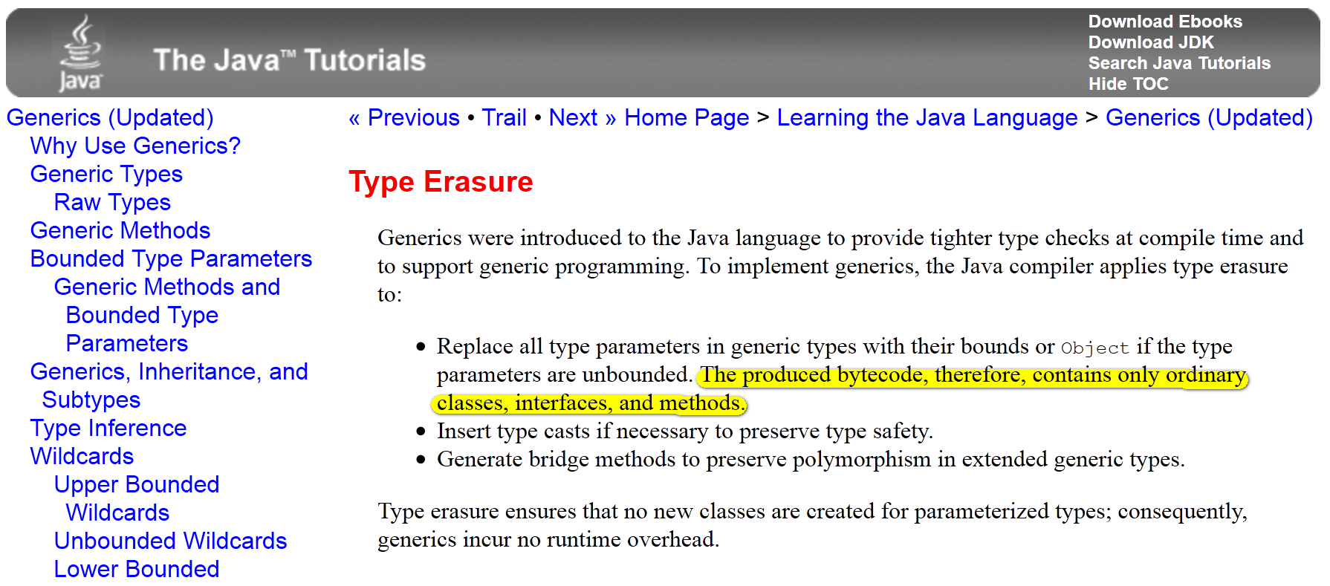
Erasure!
Notes:
CURRENT – YOAV
NEXT - YOAV

Slide 90

But where are my
compile time checks?!
Notes:
CURRENT – YOAV
NEXT - YOAV

Slide 91
“In Groovy you can insert anything anywhere”
List<Long> list = [1,2,3] def now = new Date() list << now list << 'foo' println list*.class.name
[java.lang.Long, java.lang.Long, java.lang.Long, java.util.Date, java.lang.String]
Notes:
CURRENT – YOAV
NEXT - YOAV

Slide 92
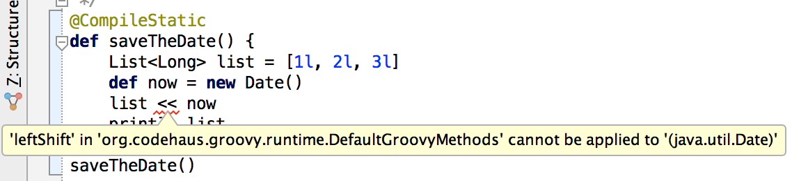
CompileStatic!
Notes:
CURRENT – YOAV
NEXT - YOAV

Slide 93


Notes:
CURRENT – YOAV
NEXT - JB
1993

Slide 94
What’s the metaclass, Baruch?
def map = [metaClass: ‘frequency'] println "What's the $map.metaClass, Baruch?"
MissingMethodException
What's the org.codehaus.groovy.runtime.HandleMetaClass@YYYYYYY [groovy.lang.MetaClassImpl@YYYYYYY[class java.util.LinkedHashMap]], Baruch?
What’s the java.util.LinkedHashMap@XXXXXX.metaClass, Baruch?
What’s the frequency, Baruch?
Notes:
CURRENT – YOAV
NEXT - JB

Slide 95
It works, but…
Not sure it’s a good thing
Notes:
CURRENT – YOAV
NEXT - JB

Slide 96

Remember James gosling told you
That operator overloading is bad?
Notes:
CURRENT – YOAV
NEXT - JB

Slide 97
Too much operator overloading!
If is overloaded
for
be overloaded for
in the same time!
map.metaClass
, it can’t
map.get('metaClass')
map.getMetaClass()
Notes:
CURRENT – YOAV
NEXT - JB

Slide 98

Notes:
CURRENT – YOAV
NEXT - JB

Slide 99
And the t-shirt goes to…
Notes:
CURRENT – YOAV
NEXT - JB

Slide 100

Prime cuts
Notes:
CURRENT – JB
NEXT - JB

Slide 101
Prime cuts
boolean isPrime(def x) { if (x == 2) return true int limit = Math.sqrt(x) + 1 (2..limit).each { if (x % it == 0) { return false } } true } println isPrime("4" as Double)
Notes:
CURRENT – JB
NEXT - JB

Slide 102

Confused? So are we.
Notes:
CURRENT – JB
NEXT - JB

Slide 103
Let’s look at it again…
boolean isPrime(def x) { if (x == 2) return true int limit = Math.sqrt(x) + 1 (2..limit).each { if (x % it == 0) { return false } } true } println isPrime("4" as Double)
Notes:
CURRENT – JB
NEXT - JB

Slide 104
boolean isPrime(def x) { if (x == 2) return true int limit = Math.sqrt(x) + 1 (2..limit).each { if (x % it == 0) { return false } } true } println isPrime("4" as Double)
true
false
NumberFormatException
MissingMethodException
Notes:
CURRENT – JB
NEXT - JB

Slide 105

Notes:
CURRENT – JB
NEXT - JB

Slide 106
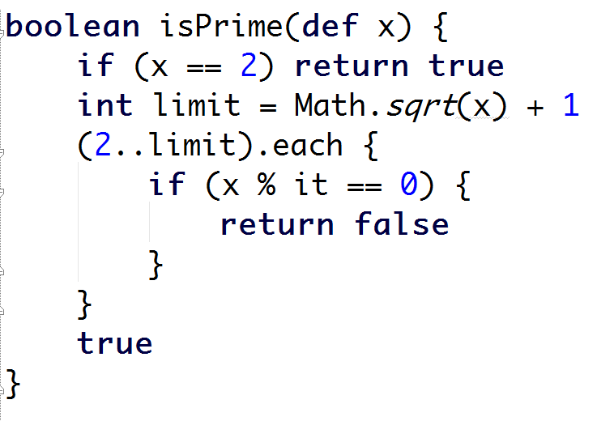
Let’s try to figure it out
Notes:
CURRENT – JB
NEXT - JB

Slide 107
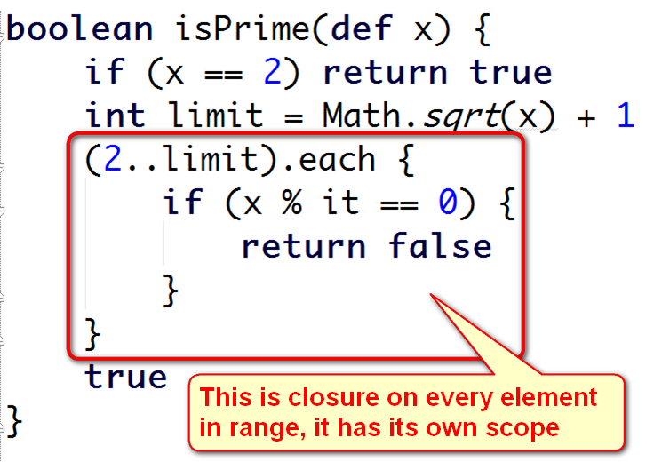
Let’s try to figure it out
Notes:
CURRENT – JB
NEXT - JB

Slide 108
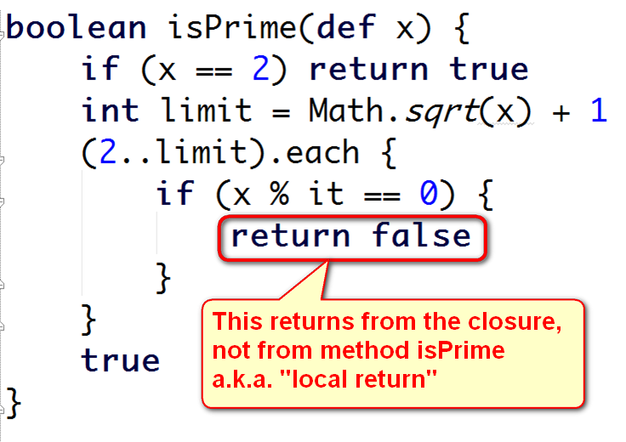
Let’s try to figure it out
Notes:
CURRENT – JB
NEXT - JB

Slide 109
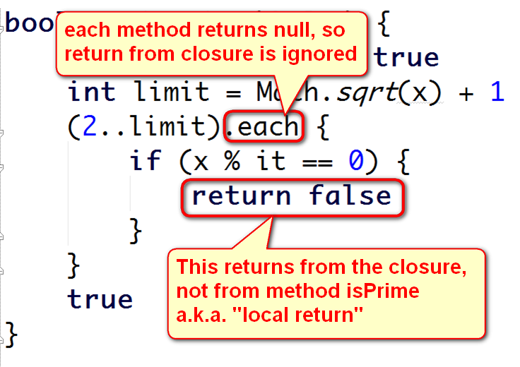
Let’s try to figure it out
Notes:
CURRENT – JB
NEXT - JB

Slide 110
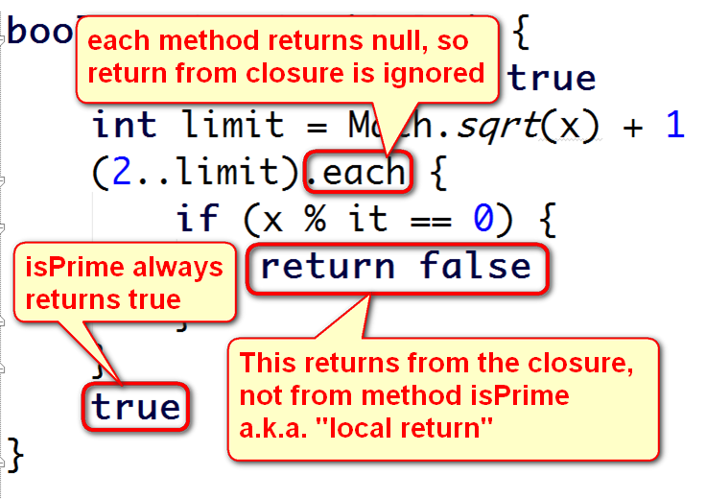
Let’s try to figure it out
Notes:
CURRENT – JB
NEXT - JB

Slide 111

Solution? Use ANY() or Rethink the algorithm
http://kousenit.wordpress.com/2014/04/18/responses-to-the-closure-of-no-return/
Notes:
CURRENT – JB
NEXT - JB

Slide 112
And the t-shirt goes to…
Notes:
CURRENT – JB
NEXT - JB

Slide 113

Jump! A.k.a. The missing lyrics
Notes:
CURRENT – JB
NEXT - YOAV
(1983)

Slide 114
Jump! A.k.a. The missing lyrics
class VanHalen { public static jump() { "Here are the ${lyrics()}" } def methodMissing(String name, def args) { 'lyrics' } } println VanHalen.jump()
Notes:
CURRENT – JB
NEXT - YOAV

Slide 115
Jump! A.k.a. The missing lyrics
Here are the lyrics
Here are the null
Startup failure
MissingMethodException
class VanHalen { public static jump() { "Here are the ${lyrics()}" } def methodMissing(String name, def args) { 'lyrics' } } println VanHalen.jump()
Notes:
CURRENT – JB
NEXT - YOAV

Slide 116

I can't believe you fell for the oldest trick in the book
Notes:
CURRENT – JB
NEXT - YOAV

Slide 117
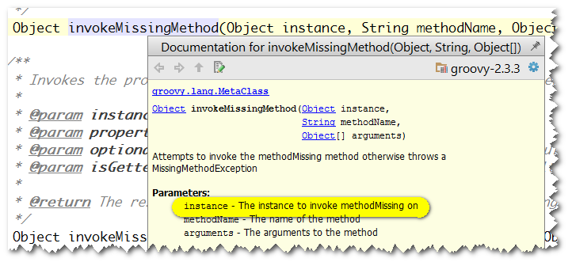
I can't believe you fell for the oldest trick in the book
Notes:
CURRENT – JB
NEXT - YOAV

Slide 118
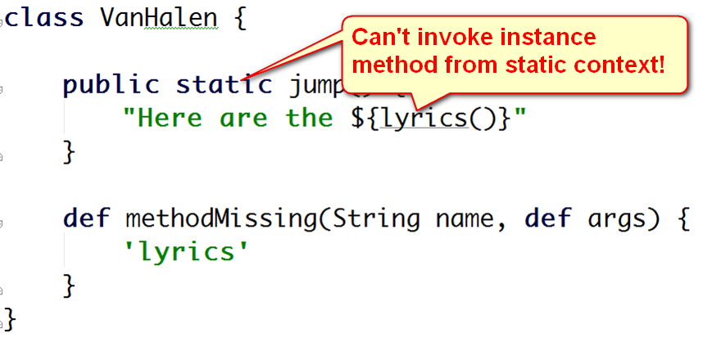
I can't believe you fell for the oldest trick in the book
Notes:
CURRENT – JB
NEXT - YOAV

Slide 119
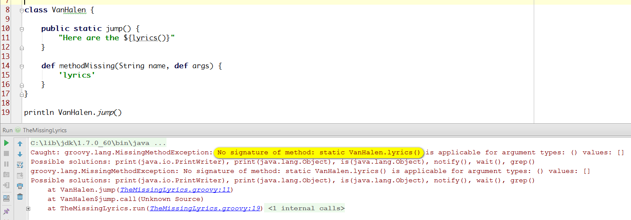
I can't believe you fell for the oldest trick in the book
Notes:
CURRENT – JB
NEXT - YOAV

Slide 120
Solution: static methodmissing
class VanHalen { public static jump() { "Here are the ${lyrics()}" } static $static_methodMissing(String name, def args) { 'lyrics' } } println VanHalen.jump()
Notes:
CURRENT – JB
NEXT - YOAV

Slide 121
Better Solution: use GooD OOP
class VanHalen { public jump() { "Here are the ${lyrics()}" } def methodMissing(String name, def args) { 'lyrics' } } println new VanHalen().jump()
Notes:
CURRENT – JB
NEXT - YOAV

Slide 122
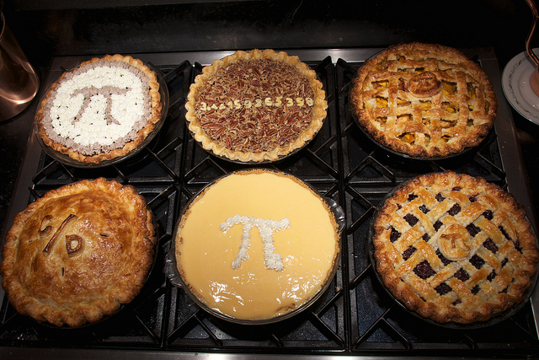
π – the food and the number
Notes:
CURRENT – YOAV
NEXT - JB

Slide 123
Double the pi
double value = 3 println "$value.14".isDouble()
true
MissingPropertyException
false
MissingMethodException
Notes:
CURRENT – YOAV
NEXT - JB

Slide 124

Got this one!
Notes:
CURRENT – YOAV
NEXT - JB

Slide 125
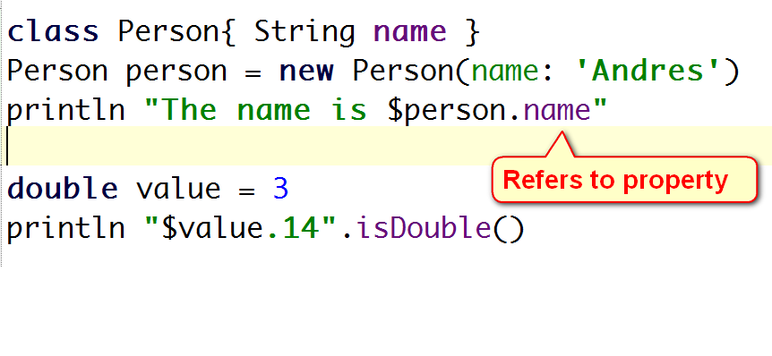
Piece of pie!
Notes:
CURRENT – YOAV
NEXT - JB

Slide 126
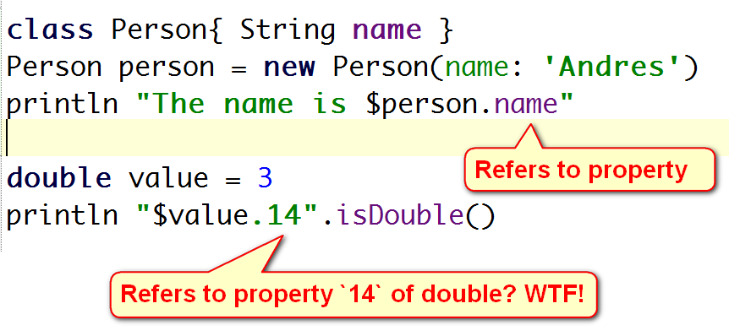
Piece of pie!
Notes:
CURRENT – YOAV
NEXT - JB

Slide 127
Double the pi
double value = 3 println "$value.14".isDouble()
true
MissingPropertyException
false
MissingMethodException
Notes:
CURRENT – YOAV
NEXT - JB

Slide 128

Notes:
CURRENT – YOAV
NEXT - JB

Slide 129

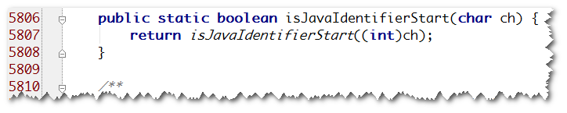
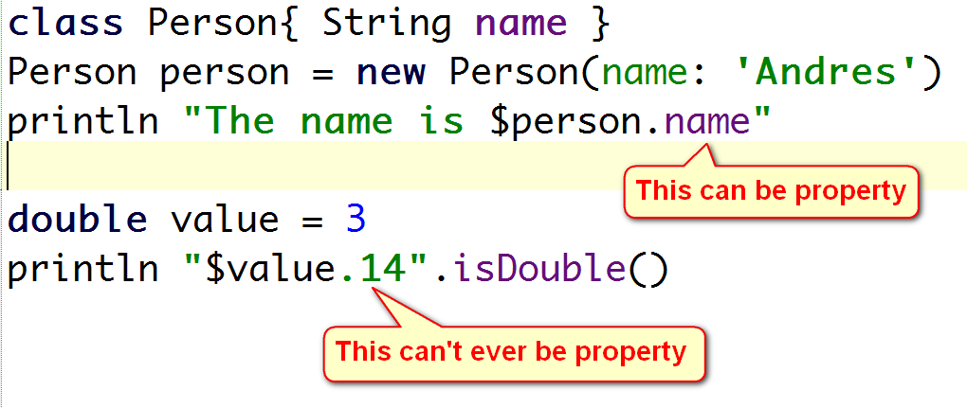
If it can’t be a property, why even bother?
Notes:
CURRENT – YOAV
NEXT - JB

Slide 130
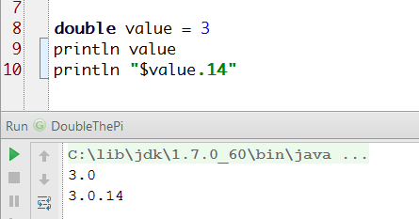
Mind the tostring() of a double
Notes:
CURRENT – YOAV
NEXT - JB

Slide 131

Ever wondered what RSVP stands for?
Ask the French guys!
Notes:
CURRENT – JB

Slide 132
RSVP
class Invite { int attending = 1 } def invite = new Invite() def attendees = (invite.attending) +1 println attendees
Notes:
CURRENT – JB

Slide 133
class Invite { int attending = 1 } def invite = new Invite() def attendees = (invite.attending) +1 println attendees
Startup Failure
1
2
MissingPropertyException
Notes:
CURRENT – JB

Slide 134

Notes:
CURRENT – JB

Slide 135
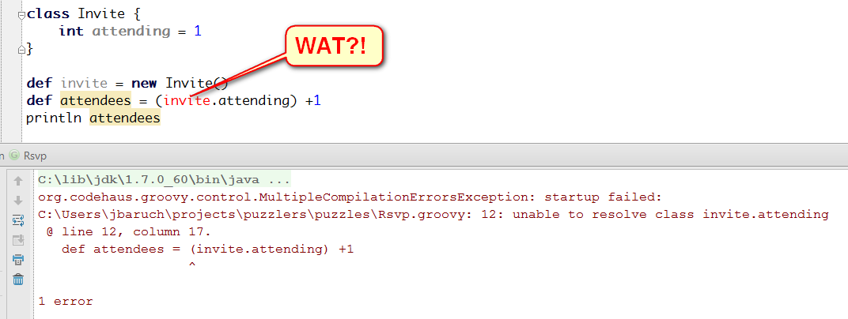
Notes:
CURRENT – JB

Slide 136
Notes:
CURRENT – JB

Slide 137
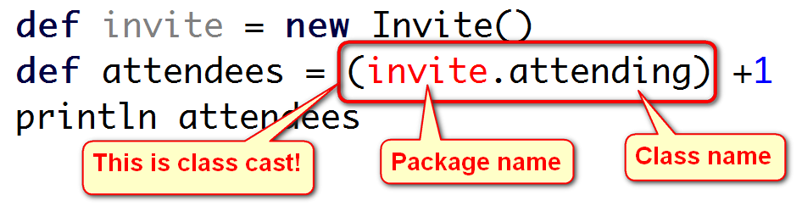
That’s why:
Notes:
CURRENT – JB

Slide 138

Notes:
CURRENT – JB

Slide 139
Fix: whatever doesn’t look like casting.
This works:
def attendees = (new Invite().attending) + 1 println attendees
This works as well:
def invite = new Invite() println (invite.attending +1)
Notes:
CURRENT – JB

Slide 140
And the t-shirt goes to….
French guy, naturally.
He’s the one to blame, BTW.
Notes:
CURRENT – FRED

Slide 141

Conclusions

Slide 142

Write readable code
Comment neat tricks
Sometimes it is just a bug
Use static code analysis (intellij IDEA!)
Rtfm
Don’t code like my brother

Slide 143

We have just started! (may end up in proper uniform)
Puzzlers? Gotchas?
puzzlers jfrog.com
Groovypuzzlers

Slide 144

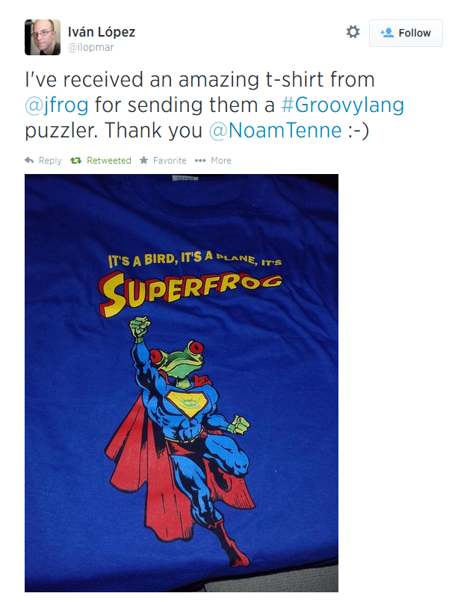
Jfrog always pays its debts

Slide 145
Positive feedback?
Praise us on twitter groovypuzzlers
Groovypuzzlers
_yoav_
jbaruch
Negative feeдback?
> /dev/null

Slide 146

No, Thank you!

